Slide 1

  Chapter Two
  Data Communication Layer

Slide 2

Chapter Outline
  Architectures
  Protocol standards
  OSI 7-layer reference model and concepts of open standards
  Motivations for standards
  ISO reference model
  Open standard
  Internetworking with TCP/IP Structure

Slide 3
Communication Architecture
Network architecture is a design of communication networks for specification of a network’s physical components and their functional organization and configuration, its operation principles and procedures as well as data formats use.
Network architecture is predominantly expressed by its use of the internet protocol suits.
Data Communication Architecture:
Network Line Configuration: defines the attachment of communication devices to a link
Or both point to point and multipoint connection are line configuration to connect two or more devices in link.
Link : a physical communication pathway that transfers data from one device to another.
point-to-point:- a line configuration where two and only two devices are connected by a dedicated link.
It is unicast connection because there is dedicated link between the two devices

Slide 4
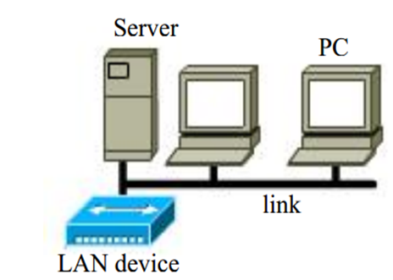
Cntd…
Multipoint – a line configuration in which more than two specific devices share a single link
  In multipoint connection a single link can be shared between multiple devices.
  Single channel shared
  Single transmitter but multiple receiver
  No dedicated line

Slide 5
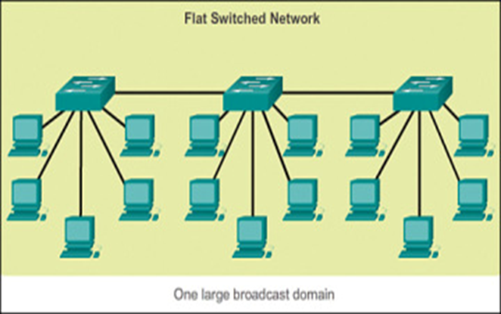
Network Design Models
Flat model:- it is single collision domain and not hierarchical divided.
It has some advantage:
  Easy to design
  Easy to implement
  It good for small network
  East to maintain and diagnosis
It has some disadvantage:
  Poor security
  No redundancy
  Less speed
  No scalability
  No networks layers
  fig.1 Flat switch network

Slide 6
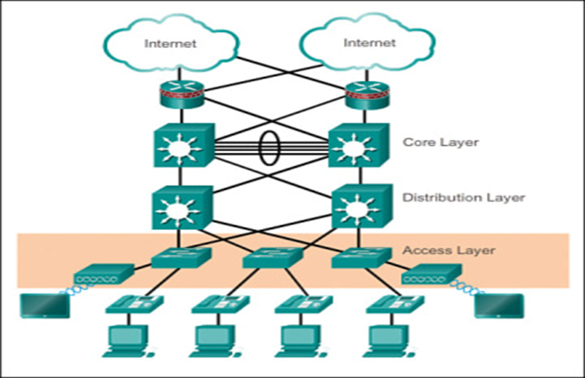
Cntd…
Hierarchical Model:– it is a network model that has three network layers or divisions and each layers has their own specific functions.
The three layers are:
Access layer: used for service availably port security on layer 2 switch
Distribution layer: aggregate data received from access layer and switches from sending to core layer, redundancy and load balancing, control broadcast domain
Core layer control: it is a network backbone, it is fast speed layer it connect multiple campus network and data center

Slide 7
Cntd…
It has some advantage of hierarchical model:
  more security
  Better speed or performances
  Facilitate scalable performance of network
  Good for big network
  Easy to troubleshoot
It has some disadvantage of hierarchical model:
  Difficult to design
  Difficult to implement

Slide 8
Network Protocols and Standards
a protocol is a set of rules that governs data communications
a protocol defines what is communicated, how it is communicated, and when it is communicated.
E.g. When one computer sends a message to another computer, the sender must perform the following general steps
  break the data into small sections called packets
  add addressing information to the packets identifying the destination computer
  deliver the data to the network card for transmission over the network
the receiving computer must perform the same steps, but in reverse order
  accept the data from the NIC
  remove transmitting information that was added by the transmitting computer
  reassemble the packets of data in to the original message

Slide 9
Cntd…
the key elements of a protocol are:
  syntax: refers to the structure or format of the data or signal level
  semantics: refers to the meaning of each section of bits
  timing: refers to when data should be sent and how fast they can be sent
Some important characteristics of a protocol are:
Direct /indirect:
If two systems share a point-to-point link - direct
systems connect through a switched communication network – indirect
Monolithic/structured
  Communications is a complex task for a single unit
  One big protocol vs. many structured protocols function as one.
Symmetric/asymmetric: Communication between peer entities Vs Client/Server

Slide 10
Standard /nonstandard
Standard are the set of rules for data communication that are needed for exchange of information among devices.
Standards which are created by various Standard Organization like IEEE , ISO , ANSI etc.
Types of Standards :
De Facto Standard - by Fact or Convention which have not been approved by organization e.g. Apple and Google
De Jure Standard – by Law or Regulations which have been approved by officially recognized body like ANSI , ISO , IEEE etc.
Non-standard protocols built for specific computers and tasks

Slide 11
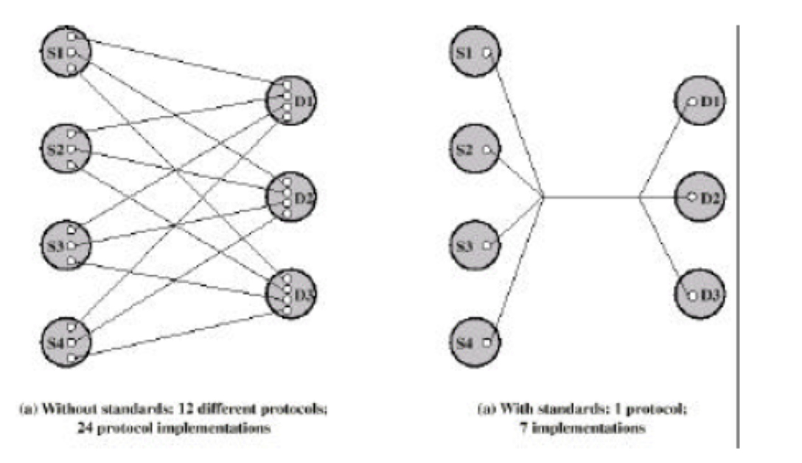
Standard /nonstandard …

Slide 12
Motivations for standards
Promote and maintain an open and competitive market for network hardware and software.
The overwhelming need for interoperability both nationally and internationally,
Increased the set of choices in terms of vendor and capability for each aspect of data communications
buy hardware and software from any vendor whose equipment meets the standard
help to promote more competition and hold down prices.

Slide 13
Layered architecture
It is to divide the design into small pieces
Each layer in the model has specific sets of procedures, functions, and protocols.
One layer can communicate with an adjacent layer by using its interface.
It provides modularity and clear interfaces
the basic elements of layered architecture are:
Service: is a set of actions that a layer provides to the higher layer.
Protocol: a set of rules that a layer uses to exchange the information with peer entity (concern both contents and order of the messages used)
Interface: is a way in which the message is transferred from one layer to another layer.

Slide 14
Layered Architecture …
Why Layered architecture required
  It provides more modular design (different teams work on different modules)
  Easy to troubleshoot and modify
  reduces complexity (one big problem to smaller ones)
  standardizes interfaces (between layers)
  assures interoperable technology
  accelerates evolution of networking technology
  simplifies teaching and learning
There are two network models which use layering.
  OSI model and IP/TCP model

Slide 15
Open Systems Interconnection (OSI) Reference Model
was developed by International Standards Organization (ISO) in 1970
It is conceptual framework describes functions of networking or telecommunication system independently from the underlying technology infrastructure.
The OSI model was originally developed to facilitate interoperability between vendors and to define clear standards for network communication.
To ensure interoperability within the communication system regardless of the technology type, vendor, and model.
It divides data communication into seven abstraction layers and standardizes protocols into appropriate groups of networking functionality

Slide 16
Open Systems Interconnection (OSI) Reference Model
Advantage of OSI model
It is a generic model and acts as a guidance tool to develop any network model.
It support layered model.
It distinctly separates services, interfaces, and protocols (flexible in nature)
It supports both connection-oriented services and connectionless services.
Disadvantage
It is purely a theoretical model does not consider the availability of appropriate technology( bad technology)
Session and presentation almost empty
duplication of services in d/nt layers like addressing, flow control and error control.
do not offer adequate solutions for practical network implementation
Bad timing and Bad politics

Slide 17
Open Systems Interconnection (OSI) Reference Model
Why OSI important
Network communication is broken into smaller, more manageable parts.
Allows different types of network hardware and software to communicate with each other.
All layers are independent and changes does not affect other layers.
Easier to understand network communication.

Slide 18
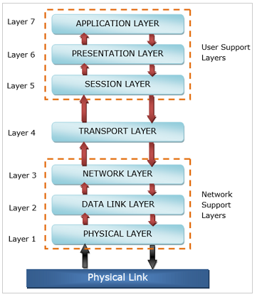
Open Systems Interconnection (OSI) Reference Model …
OSI Model has seven layers

Slide 19
Open Systems Interconnection (OSI) Reference Model …
Each layer provides a service to the layer above it and gets service from below it in the protocol specification.
Each layer communicates with the same layer’s software or hardware on other computers.
Each layer should perform a well-defined function
The lower 4 layers (transport, network, data link and physical : Layers 4, 3, 2, and 1) are concerned with the flow of data from end to end through the network.
The upper three layers of the OSI model (application, presentation and session: Layers 7, 6 and 5) are orientated more toward services to the applications.
Data is Encapsulated with the necessary protocol information as it moves down the layers before network transit.

Slide 20
Open Systems Interconnection (OSI) Reference Model …

Slide 21
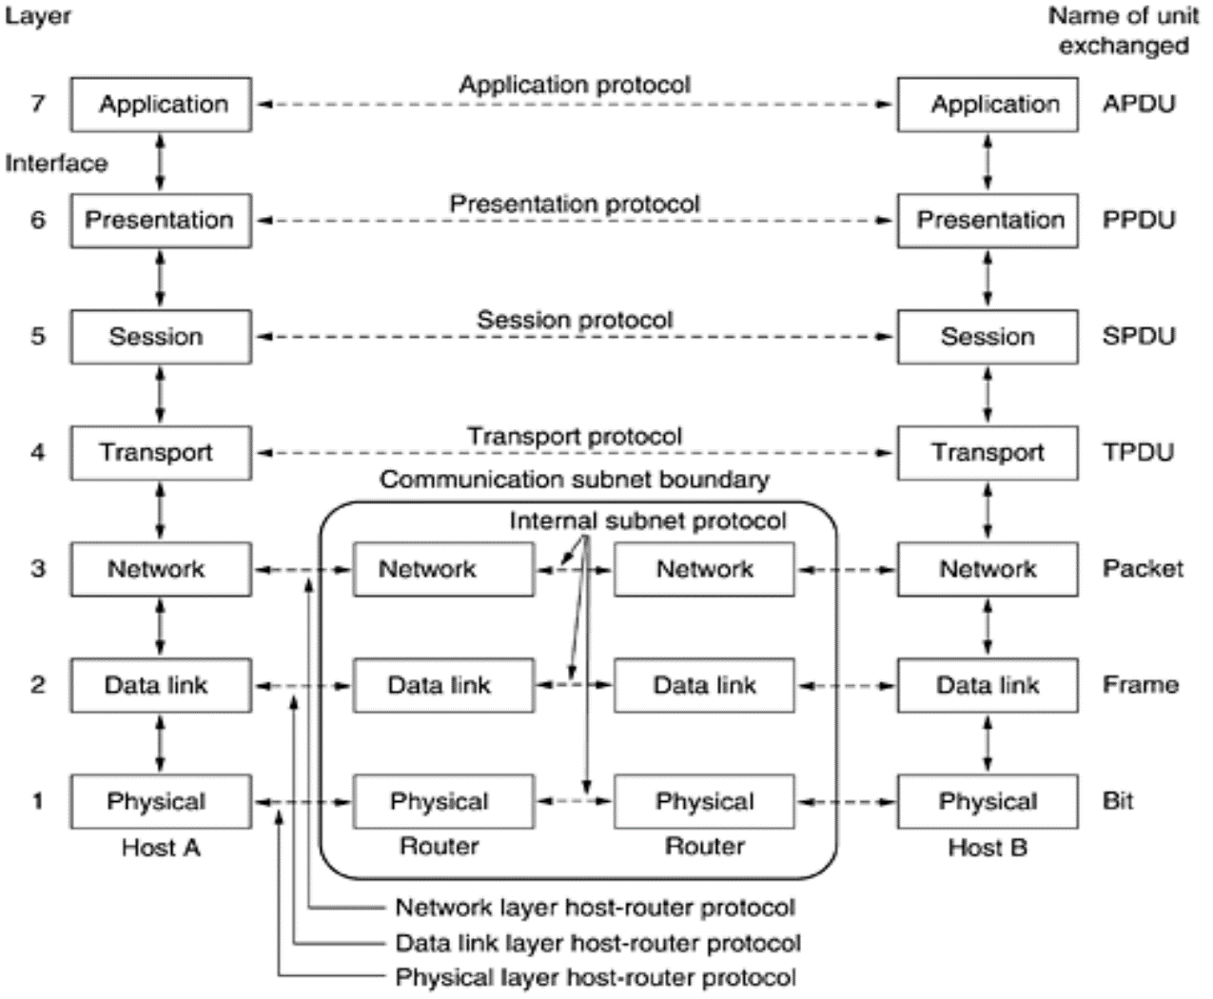
Open Systems Interconnection (OSI) Reference Model …

Slide 22
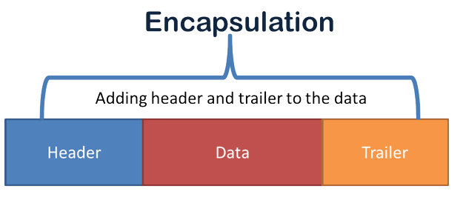
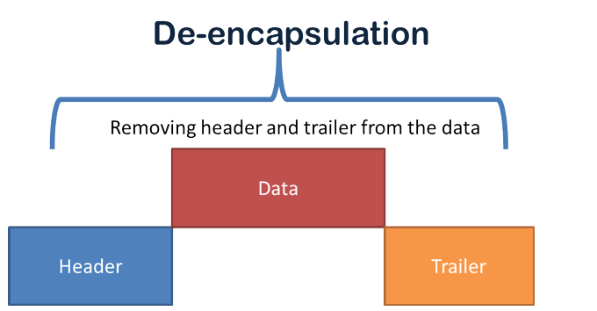
Cntd…
Encapsulation :- is a process in which protocol information is added to the data.
de-encapsulation:-is a process in which information added through the encapsulation process is removed

Slide 23
Functions of the seven layer of OSI model
Layer 7: Application
The application layer is the OSI layer that is closest to the user.
It provides network services to the user’s applications.
contains all the higher level protocols that are commonly needed by users
Layer 6: Presentation
The presentation layer ensures that the information that the application layer of one system sends out is readable by the application layer of another system.
Dara conversion , character code translation between multiple data formats by using a common format.
Provides encryption , decryption and compression of data.
Examples :- JPEG, MPEG, ASCII, EBCDIC, HTML.

Slide 24
Cntd…
Layer 5: Session
the session layer manages sessions between servers to coordinate communication.
responsible for a range of functions including opening, closing, and re-establishing session activities, authentication and authorization of communication between specific apps and servers, Identifying full-duplex or half-duplex operations
synchronizing data streams between two hosts' presentation layers and manages their data exchange.
  preventing two parties from attempting the same critical operation at the same time
The session layer offers provisions for efficient data transfer.
  Check pointing long transmissions to allow them to continue from where they were after a crash
Examples :- SQL, ASP(AppleTalk Session Protocol), Remote procedure call protocol (RPC)

Slide 25
Cntd…
Layer 4: Transport
It ensures that messages are transmitted in the order in which they are sent and no duplication of data
It receives the data from upper layer and converts into smaller units known as segments.
Services include:
  Service point addressing
    Port number
  Segmentation /reassembly
  Connection control
    .Connectionless or connection oriented
  Flow and error control

Slide 26
(Transport layer )Cntd…
Segmentation and reassembly
the message receives from the upper layer, it divides the message into multiple segments and each segment is assigned with a sequence number that uniquely identifies each segment.
When the message has arrived at the destination, then the transport layer reassembles the message based on their sequence numbers.
reasons for segmentation:
  the communication network may only accept blocks of data up to a certain size
  error control may be more efficient with a smaller frame size; fewer bits need to be retransmitted when a frame gets corrupted
  facilitates more equitable access to shared transmission facilities(allows session multiplexing)

Slide 27
(Transport layer ) Cntd…
disadvantages
  If one segmented packet is missing , then the overall file cannot be read
  Needs a queuing and rebuilding system for segmented packets
  Time it takes to Processing
  More Bandwidth of Overhead
Service-point addressing:- adds the header that contains the address known as a service-point address or port address
It is to transmit the message to the correct process( process to process)

Slide 28
Transport layer ) Cntd…
Connection control: two types of protocols (services)
Connection-oriented service :- a logical association or connection is established between the communicating computers (devices).
Three phases are involved
  connection establishment (agreement to exchange data)
  data transfer (data and control information exchanged)
  connection termination (termination request) - by any of the two parties
  TCP (Transport Control Protocol) is connection-oriented
The key characteristics of connection-oriented data transfer is that sequencing is used each side sequentially numbers the frames that it sends to the other side.

Slide 29
Transport layer ) Cntd…
Sequencing supports three main functions
1. Ordered delivery: frames may not arrive in the order in which they were sent, because they may traverse different paths
2. flow control: a receiving station has to limit the amount or rate of data that is sent by a transmitting station
  the simplest form of flow control is stop-and-wait procedure in which each frame must be acknowledged before the next can be sent
  more efficient protocols involve some form of credit provided to the transmitter, which is the amount of frames that can be transmitted without an acknowledgement; e.g. sliding window technique

Slide 30
Cntd…
3. Error control: is implemented as two separate functions; error detection and retransmission
error detection and error correction
if an error is detected, the receiver discards the frame
upon failing to receive an acknowledgement to the frame in a specified reasonable time, the sender retransmits the frame
some protocols also employ error correction which enables the receiver not only to detect errors but, in some cases, to correct them

Slide 31
Cntd…
2. connectionless service
  no need for connection establishment or connection release to sent packet
  each segment treats as an individual packet, and travel in different routes to reach the destination.
  the packets are not numbered, they may be delayed, lost, or arrive out of sequence, no acknowledgement
  UDP (User Datagram Protocol), one of the transport layer protocols, is connectionless
  good for one time transaction; e.g., email

Slide 32
Cntd…
Multiplexing:
occurs when multiple connections share a single connection (multiple access)
Transmission services
  a variety of additional services can be provided
  Quality of services(priority:) control traffic and ensure the performance of critical applications with limited network capacity.
  It enables organizations to adjust the overall network traffic by prioritizing specific high-performance applications
  security: security mechanisms, restricting access, may be invoked

Slide 33
Cntd…
    Layer 3: Network
    It provides a logical connection between different devices.
    Defines end-to-end delivery of packets.
    Defines logical addressing so that any endpoint can be identified.
    Defines how routing works and how routes are learned so that the packets can be delivered.
    The network layer also defines how to fragment a packet into smaller packets to accommodate different media.
    Examples :- IP, IPX, AppleTalk.

Slide 34
Cntd…
Layer 2: Data Link
data transmission between the nodes within a network and manages the connections between physically connected devices such as switches.
The raw data received from physical layer is synchronized and packaged into data frames.
The data link layer is divided into two sublayers:
Logical Link Control (LLC) sublayer is responsible for flow controls and error controls that ensure error-free and accurate data transmission between the network nodes.
Media Access Control (MAC) sublayer is responsible for managing access and permissions to transmit data between the network nodes.

Slide 35
Cntd…
Layer 2: Data Link ...
The data link layer provides reliable transit of data across a physical link by using the Media Access Control (MAC) addresses.
The data link layer uses the MAC address to define a hardware or data link address in order to uniquely identify multiple stations to locally.
Examples :- Ethernet, Frame Relay, FDDI.

Slide 36
Cntd…
Layer 1: Physical
the layer that actually interacts with the transmission media
the physical part of the network that connects network components together
involved in physically carrying information from one node in the network to the next
The physical layer deals with the physical characteristics of the transmission medium.
It defines
  mechanical: the size and shape of the network connector, how many pins does the network connector has and what each pin is used for
  electrical: how many volts represent a 1 and how many a 0
  Data transmission performance, such as Bit Rate and Bit Synchronization
  Communication modes such as Simplex, Half Duplex, and Full Duplex

Slide 37
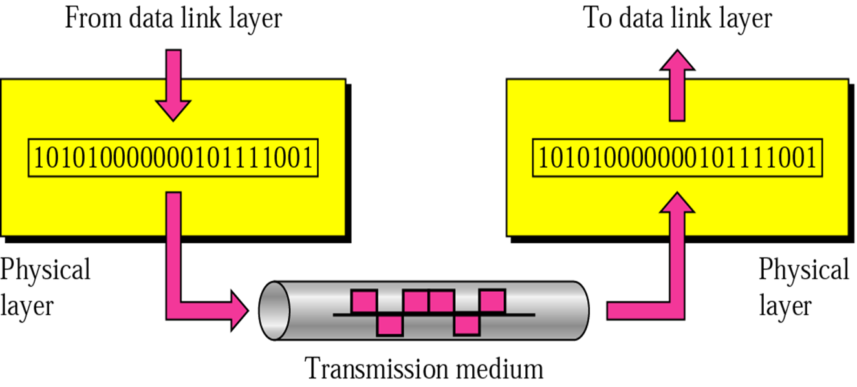
Cntd…
Such characteristics as voltage levels, timing of voltage changes, physical data rates, maximum transmission distances, physical connectors, and other similar attributes are defined by physical layer specifications.
Examples :- EIA/TIA-232, RJ45, BNC
Notes:
A BNC (Bayonet Neil-Concelman, or sometimes British Naval Connector) connector is used to connect a computer to a coaxial cable in a 10BASE-2 Ethernet network.

Slide 38
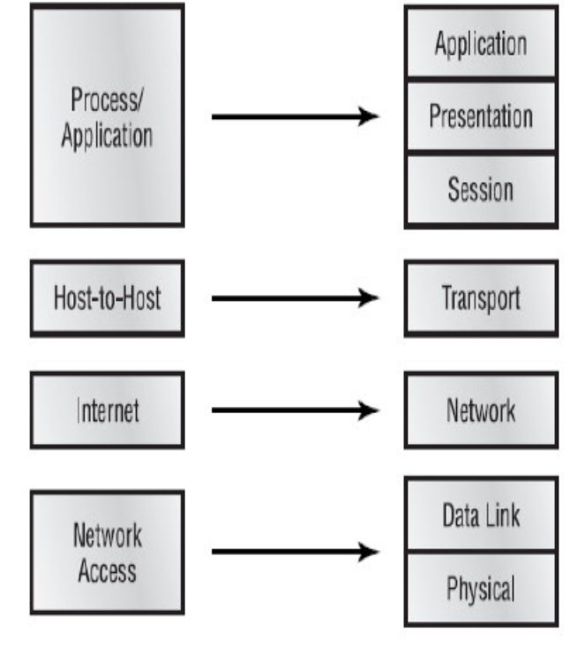
TCP/IP Reference Model
used in the grandparent of all wide area computer networks, the ARPANET
Developed by Department of Defense (DoD) to ensure and preserve data integrity as well as maintain communication in the even of catastrophic war
Condensed version of OSI model – contains four layers instead of seven

Slide 39
Functions of layer
Goals
The Process/Application : protocols for node-to-node application communication and also controls user-interface specifications.
The Host-to-Host
  parallels the functions of the OSI’s Transport layer, defining protocols for setting up the level of transmission service for applications.
The Internet layer
  corresponds to the OSI’s Network layer, designating the protocols relating to the logical transmission of packets over the entire network.
Network Access layer
The equivalent of the Data Link and Physical layers of the OSI model
Oversees hardware addressing and defines protocols for physical transmission data.

Slide 40
Cntd…
Shortcomings of TCP/IP
  the model does not clearly separate the concepts of service, interface, and protocol
  It is not generic in nature which fails to represent any protocol stack other than the TCP/IP suite e.g. cannot describe the Bluetooth connection.
  the host-to-network layer is not really a layer at all
  does not distinguish (or even mention) the physical and data link layers

Slide 41
OSI vs. TCP/IP
In OSI:
  Network –Connectionless/ Connection oriented
  Transport –Only Connection oriented
In TCP/IP:
  Transport - Connectionless/ Connection oriented
  Very useful for simple request reply
  Network – Only Connectionless
OSI:
  Difficult to Implement

Slide 42
Cntd…
OSI: Service, Interfaces and protocols
  Layers Interface: How layer above it access it, what parameter and results to expect
  Peer protocols: Used in a layer’s business
  Layer is equivalent to an Object
    Set of methods
TCP/ IP–no distinction between protocol and service
  IP :- Send IP packet and Receive IP packet
Host - to - network (TCP/IP)
  Not really a layer. Interface between network and data link layer
  No distinction between physical and data link layer
  Adhoc application layer protocols
    TELNET: Virtual terminal designed for a character terminal
    no more than a UI

Slide 43
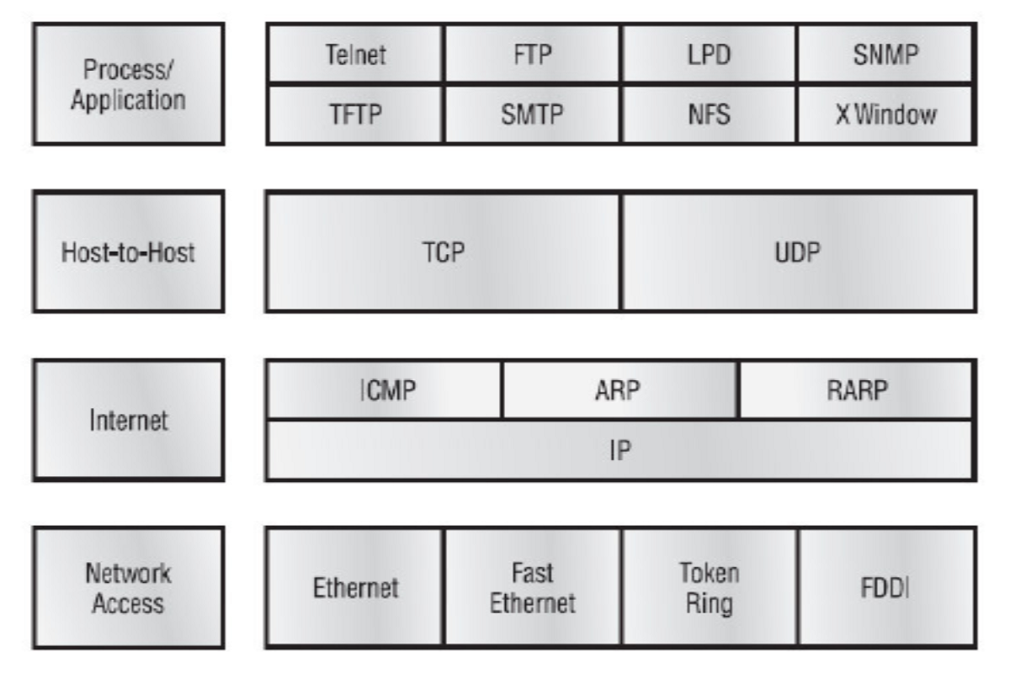
TCP/IP protocol suits

Slide 44
Application/ process layer protocols
Telnet - allows a user on a remote client machine, called the Telnet client, to access the resources of another machine, the Telnet server.
  Telnet makes client machine appear as though it were a terminal directly attached to the server.
File Transfer Protocol (FTP) - is the protocol that actually lets us transfer files, and it can accomplish this between any two machines using it.
  Usually users are subjected to authentication
Network File System (NFS) – is distributed file system protocol allows a user on a client computer to access files over a network in the same way as access a local storage file. it is an open standard, anyone can implement the protocol.

Slide 45
Cntd…
Simple Mail Transfer Protocol (SMTP) - uses a spooled, or queued, method of mail delivery.
  POP3 is used to receive mail.
Simple Network Management Protocol (SNMP) - collects and manipulates valuable network information.
  This protocol stands as a watchdog over the network, quickly notifying managers of any sudden turn off events.
Domain Name Service (DNS) – resolves hostnames—specifically, Internet names, such as www.amu.edu.et to the IP address 10.144.5.30
Dynamic Host Configuration Protocol (DHCP) - gives IP addresses to hosts.
  It allows easier administration and works well in small-to-even-very large network environments.
Notes:
Attenuation= thinning or decreasing

Slide 46
Host-to-Host layer
Transmission Control Protocol (TCP) - takes large blocks of information from an application and breaks them into segments.
It numbers and sequences each segment so that the destination’s TCP protocol can put the segments back into the order the application intended.
Uses three way handshaking
User Datagram Protocol (UDP) - does not sequence the segments and does not care in which order the segments arrive at the destination. But after that, UDP sends the segments off and forgets about them. It doesn’t follow through, check up on them, or even allow for an acknowledgment of safe arrival — complete abandonment.
TCP for reliability and UDP for faster transfers.

Slide 47
Cntd…
TCP and UDP must use port numbers to communicate with the upper layers, because they’re what keeps track of different conversations crossing the network simultaneously.
These port numbers identify the source and destination application or process in the TCP segment.
There are 2^16 = 65536 ports available.
  Well-known ports - The port numbers range from 0 to 1023.
  Registered ports - The port numbers range from 1024 to 49151.
    Registered ports are used by applications or services that need to have consistent port assignments.
  Dynamic or private ports - The port numbers range from 49152 to 65535. These ports are not assigned to any protocol or service in particular and can be used for any service or application.

Slide 48
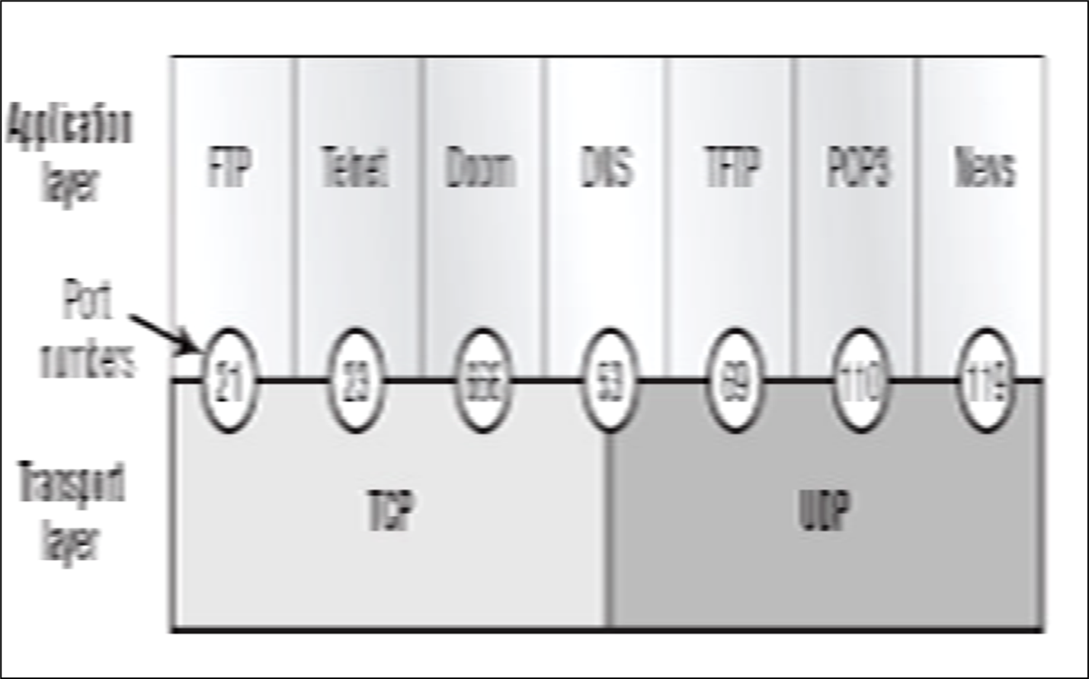
Cntd…
If a port is closed/blocked, you cannot communicate with the computer by the protocol using that port.
  Eg. If port 25 is blocked you cannot send mail.
  Firewalls by default block all ports.
  You should know the port numbers of different protocols!!

Slide 49
Internet Layer
Internet Protocol (IP) essentially is the Internet layer.
The other protocols found here merely exist to support it.
It can do this because all the machines on the network have a software, or logical, address called an IP address.
Internet Control Message Protocol (ICMP) works at the Network layer and is used by IP for many different services.
  ICMP is a management protocol and messaging service provider for IP.
  The following are some common events and messages that ICMP relates to:
    Destination host Unreachable:- occurs when the user host or its gateways can’t find a path to reach the destination.
    Buffer Full If a router’s memory buffer for receiving incoming datagrams is full, it will use ICMP to send out this message until the congestion abates.

Slide 50
Cntd…
Hops Each IP datagram is allotted a certain number of routers, called hops, to pass through. If it reaches its limit of hops before arriving at its destination, the last router to receive that datagram deletes it.
The executioner router then uses ICMP to send a message, informing the sending machine of the end of its datagram.
Ping (Packet Internet Groper) uses ICMP echo messages to check the physical and logical connectivity of machines on a network.
Trace route Using ICMP timeouts, Traceroute is used to discover the path a packet takes as it traverses an internetwork.
Address Resolution Protocol (ARP) finds the hardware address of a host from a known IP address.
  ARP interrogates the local network by sending out a broadcast asking the machine with the specified IP address to reply with its hardware address.

Slide 51
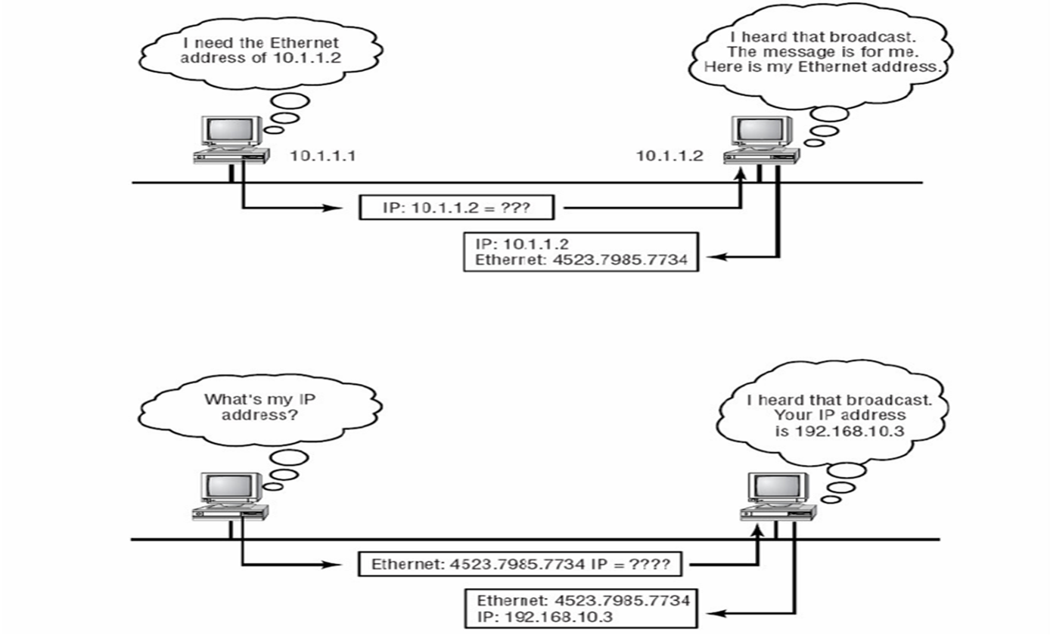
Cntd…
Reverse Address Resolution Protocol (RARP)
discovers the identity of the IP address for diskless machines by sending out a packet that includes its MAC address and a request for the IP address assigned to that MAC address.
A designated machine, called a RARP server, responds with the answer, and the identity crisis is over.

Slide 52
Network Access
  Wi-Fi(wireless fidelity)
  ATM
  PPP
  Ethernet
  Fast Ethernet
  FDDI
  Token ring
  Network Access technology detail explanation is reading assignment

Slide 53
  End of chapter Two
  Any question??

